Slide 1
Where and how can REDD+ deliver most benefits?

Slide 2
Benefits from REDD+
REDD+ has benefits and risks, dependent on how its implemented
Real examples of country priorities for REDD+
- soil erosion control for hydroelectricity
- reducing human-wildlife conflict
- wildlife conservation and tourism
- protection of sacred sites

Slide 3
UNFCCC safeguards lead to additional benefits
Part of safeguard (e): actions are.. used to ... enhance other social and environmental benefits
Designing REDD+ actions to deliver these benefits also helps to:
ensure local communities & Indigenous Peoples benefit
meet national goals on development & environment
Which REDD+ actions are chosen, where and how implemented influence benefits

Slide 4
Addressing safeguards in national strategies
Paragraph 72 of decision 1/CP.16 - the COP “Also requests developing country Parties, when developing and implementing their national strategies or action plans, to address, inter alia, drivers of deforestation and forest degradation, land tenure issues, forest governance issues, gender considerations and the safeguards identified in paragraph 2 of annex I to this decision, ensuring the full and effective participation of relevant stakeholders, inter alia, indigenous peoples and local communities;”

Slide 5
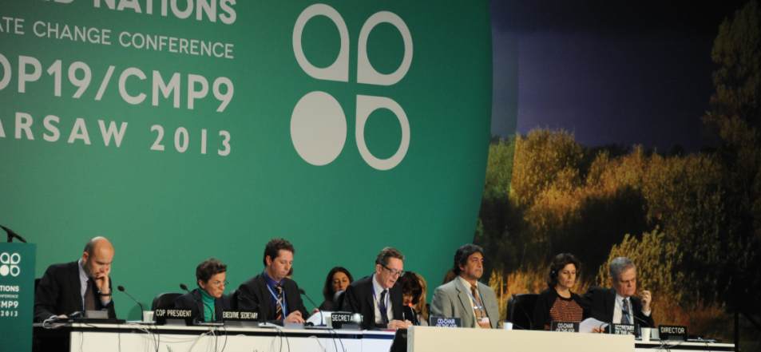
Warsaw Framework – requirements for results based payments from REDD+
1. National REDD+ strategy or action plan
3. National forest monitoring system
2. National forest reference emission level and/or reference level
4. Safeguard Information System: how the REDD+ safeguards are being addressed and respected

Slide 6
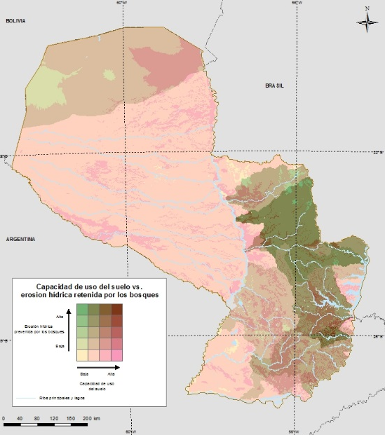
Benefits and risks in national strategies
Aim to balance potential benefits and risks from proposed REDD+ actions with the costs
Key part of identifying realistic options
Mapping can help identify areas with:
least costs
greater benefits
risks identified and minimized

Slide 7
Identify areas with fewest risks, most benefits, at least cost
Identify REDD+ actions (PAMs) that can achieve those goals by tackling drivers
Identify the potential benefits, risks and costs associated with these actions - spatially
Identify possible priority areas for each REDD+ action – refines scope
Identify goals of REDD+ for the country: what benefits is REDD+ expected to deliver?
Design the implementation of actions to promote benefits and minimize risks

Slide 8
Understanding the range of benefits from forests
Mapping of additional benefits in Panama
Importance for tourism
Importance for soil erosion control
Importance for biodiversity
Biomass carbon stocks

Slide 9
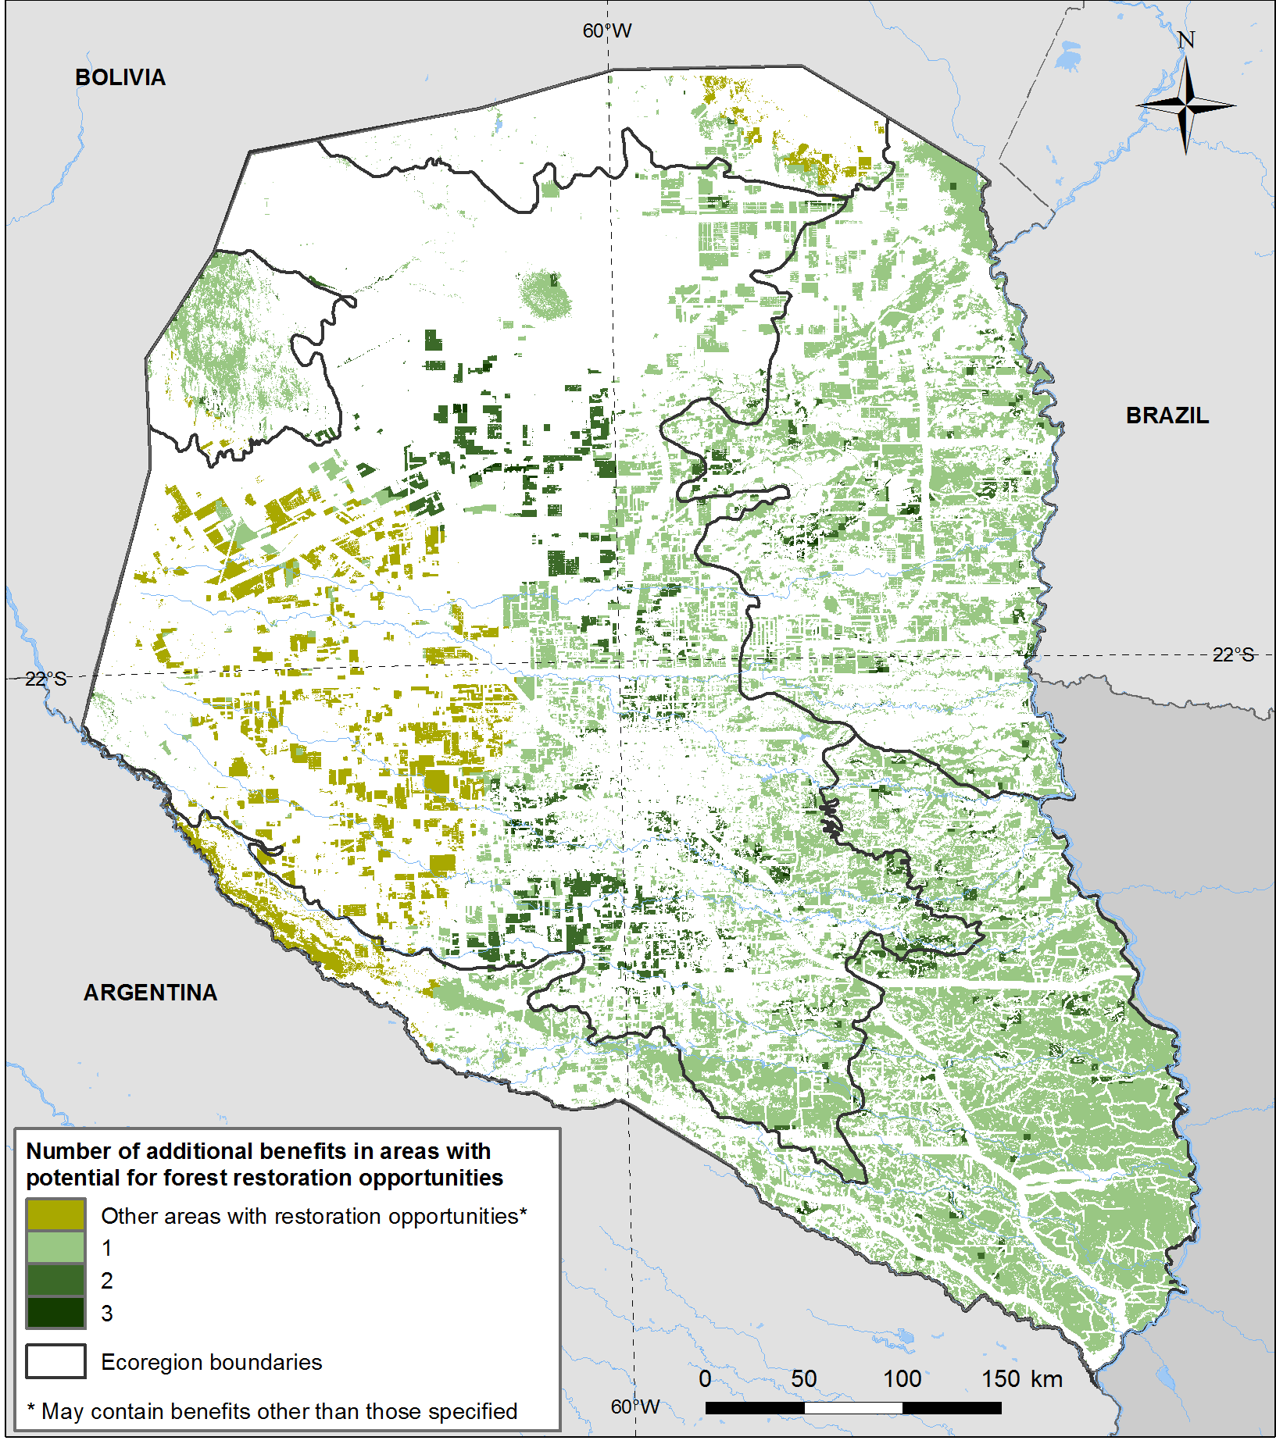
Multiple biodiversity benefits in areas with potential forest restoration opportunities in the Chaco region
Priority areas depend on benefits selected
priority sites for endemic species (plants, amphibians, mammals and birds)
areas considered of value to the diversity of habitat
fragile ecosystems
biodiversity corridors (GEF 2003)

Slide 10
Cost-benefits in REDD+
Woodfuel use - improved charcoal burning & cookstove efficiency
Benefits
Costs
Programme start-up
Ongoing support
Risks to ameliorate
Improved efficiency increases production area
Reduced demand ---> loss of livelihoods
Direct economic benefits for users and producers
Opportunity to target policy to decrease degradation of specific high-value forest

Slide 11
Support to countries on REDD+ planning
Advancing towards practical decision support
Where REDD+ actions feasible (suitability, costs)
Integrating safeguards: risks & benefits
Collaborative working sessions
Designing & doing analysis, bringing together data from national and other sources
Training on GIS techniques
Including transition to open-source

Slide 12
Thank you!
lera.miles@unep-wcmc.org

Slide 13
Buzz
How could information on the value of ecosystem services be brought together with mapping work to better inform REDD+ choices?
Comment l’information sur la valeur des services écosystémiques pourrait-elle être intégrée à la cartographie pour la prise de décisions sur la REDD+?

